Slide 1
Chatbot using python and NLP

Slide 2
OBJECTIVE
The main objective of our work has been to design, implement and evaluate a QA system to specifically deal with text based queries, creating and evaluating new techniques whenever analyse text based queries, they will provide perfect solution this system.

Slide 3
ABSTRACT
Natural language processing (NLP) is a form of artificial intelligence (AI) which is used to process the natural language data such as text, image, video, and audio. NLP act as a tool for computer to understand and analyse the real-time data in human language. The applications of NLP are machine translation, information extraction, text summarization, and question answering. Question answering (QA) is a well-researched problem in NLP. QA system is similar to information retrieval system. In QA system, the user will state a query to the system then the query will be processed by NLP methods to retrieve the answer. Neural network plays a major role in training the QA system. Neural network is a model consists of series of algorithm to determine the relationship among the dataset by mimic the working of human brain. Tensor flow (TF) is one of the frameworks to train the neural network in an efficient way. It automatically calculates the gradient by expressing numerical computations as a graph. TF is trained with the large dataset to find the similarity between question and answer. Our system answers the factoid questions over paragraphs using neural networks along with tensor flow framework. In order to justify the retrieved answer reasoning is used. Reasoning is the process of analysing data in a logical way to make decisions. In QA system reasoning plays an important role for extracting the answers with better accuracy.

Slide 4
Existing system
Fuzzy questions which cannot represent information need of users correctly are termed as fuzzy questions. Then to get as concise information as possible for natural language questions using computers leads to Question answering (QA). In contrast with traditional queries retrieval systems/search engines, which return ranked lists of potentially relevant queries that users must then manually browse through, question answering systems attempt to directly provide users one or more concise answers in the form of sentences or phrases to natural language questions.

Slide 5
Disadvantage
Early QASs were developed for restricted domains and have limited capabilities.
Current QASs focus on types of questions generally asked by users, but difficult to analyse the correct result.
Time period to analyse very difficult.

Slide 6
Proposed system
In this paper, we describe answer extraction method for factoid questions Question answering (QA) systems can be seen as information retrieval systems which aim at responding to natural language queries by returning answers rather than lists of result we analysed each type of questions and developed answer extraction patterns for these types of questions. For automatic evaluation, we have developed education based evaluation for answers of questions. Education method is originally proposed and we applied education method for question answering evaluation.

Slide 7
Advantage
This very simple approach shows the important role of semantic processing that has characterized Question Answering from its beginning, exploiting information other than facts available in database systems, and distinguished it from information retrieval.
QA systems cover a wide scope of different techniques, such as question type ontology.

Slide 8
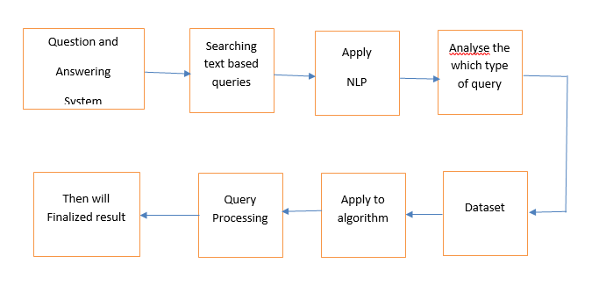
System Architecture

Slide 9
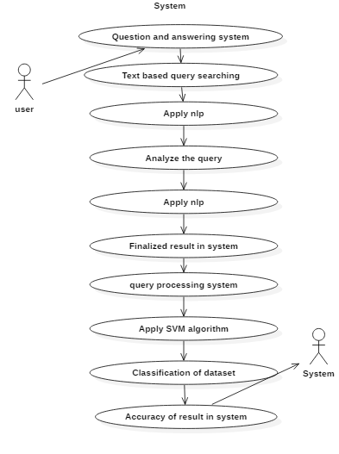
Use Case

Slide 10
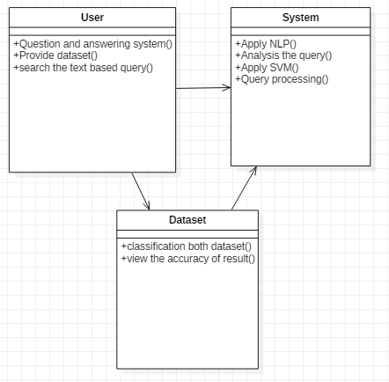
Class Diagram

Slide 11
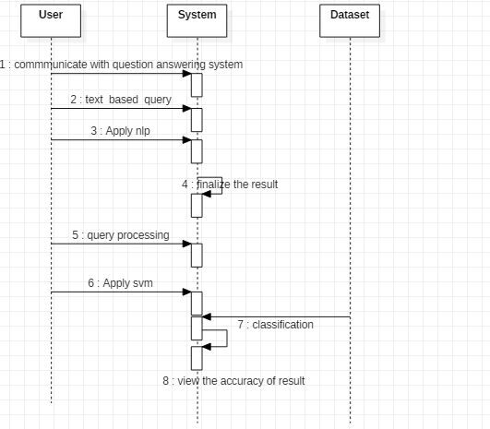
Sequence Diagram

Slide 12
HARDWARE AND SOFTWARE SPECIFICATION
Hardware:
Windows 7,8,10 64 bit
RAM 4GB
Software :
Anaconda Navigator
Python

